Slide 1

2020-Winter SMWU-KYU Interdisciplinary Hackathon
Team MEmbers
KYU : Naoto Ikemoto, Ishikawa Keigo SMWU: Jeongin Sun, JungHyun Moon, Yejin Jeong.

Slide 2
CONTENTS
About US
-Team BF
-Logo & Symbol
About Project
-project Background
-Project Objectives
-Diffrentiation
Project Methodology
Process of System
Conclusion & Plans
Demonstration

Slide 3
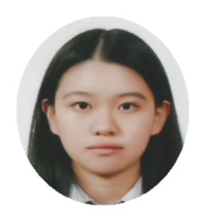


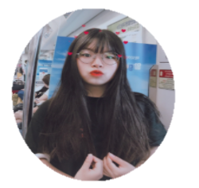
About US
YEJIN JEONG
JYUNGHYUN MOON
JEONGIN SUN
SMWU
SMWU
SMWU
Hospitality & Management
Computer Science
Electronic Engineering
Web Designer
Developer
Developer
Notes:
This is our Team members from Sookmyung Women’s University.

Slide 4
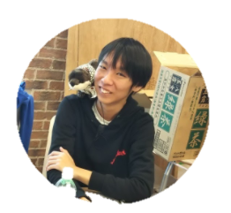
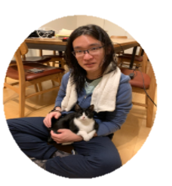
About US
ISHIKAWA KEIGO
NAOTO IKEMOTO
KYU
KYU
Education
Brain Science
Research & PT Design
Research & PT Design
Notes:
This is our Team members from Kyu shu university.
Two members take a role of Research Data and design.

Slide 5
About US
Logo & Symbol
Best Friend
+
Barrier Free

Slide 6
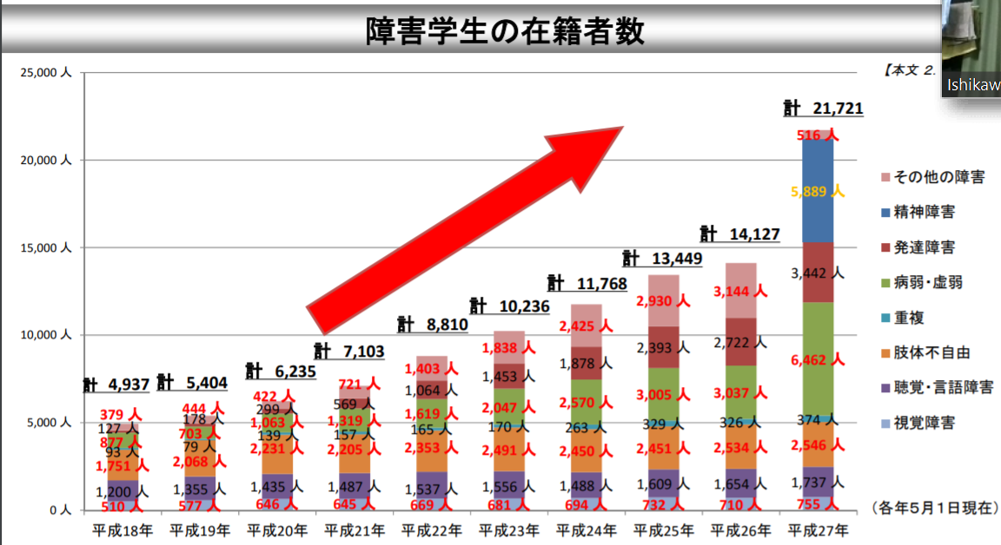
About Project
Project Background
Percentage of disabled students in Japan
Percentage of Korean University Student Volunteers
In Japan, about 1600 students have disable for listening.
There are only 15 volunteers per university.
→Their path to higher education has been blocked, Because there is insufficient support for the disabled students in universities.
Notes:
In Japan, about one thousand and six hundred students have disable for listening. But only 33% of students offer to help.
And, Low-Hearing Student’s university enrollment rate is stable low compare with total rate.
There are only about 15 helpers per university that Supprot disabilities. And also according to the interviews with officials and assistants at the Disabled Students Support Center, the university was suffering from a lack of manpower to operate the Disabled Students Support Center. As a result, support centers are suffering from chronic manpower shortages.
Their path to higher education has been blocked, Because there is insufficient support for the Hearing-impaired students at universities.

Slide 7
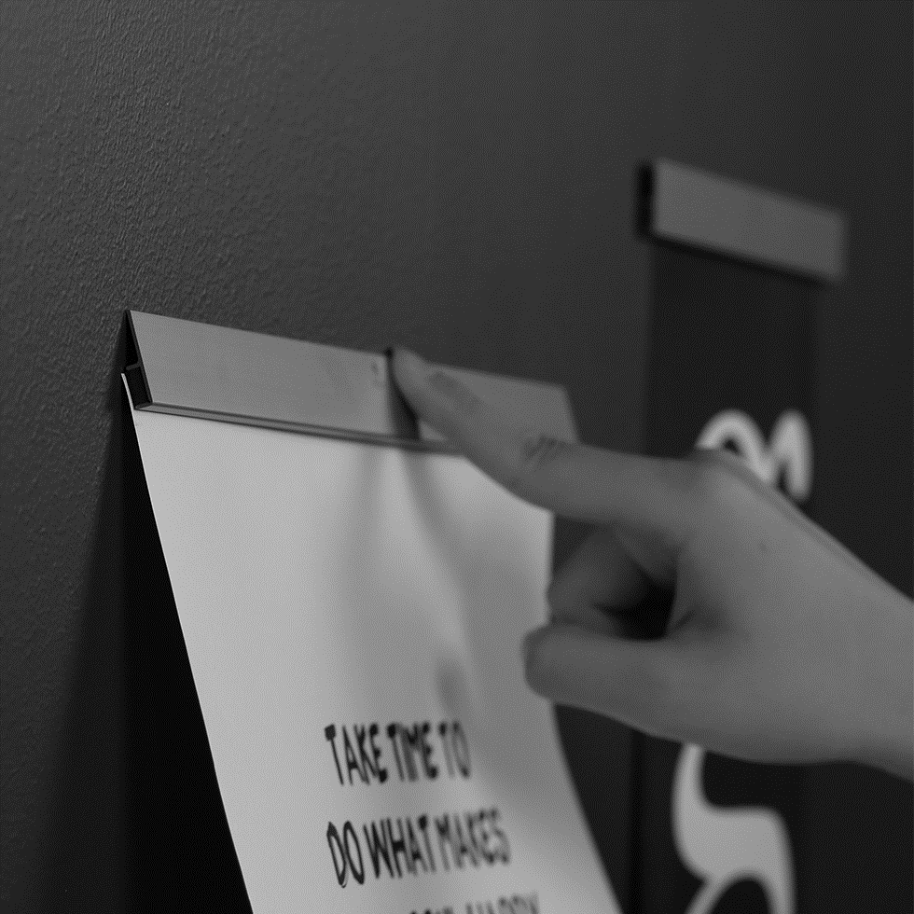
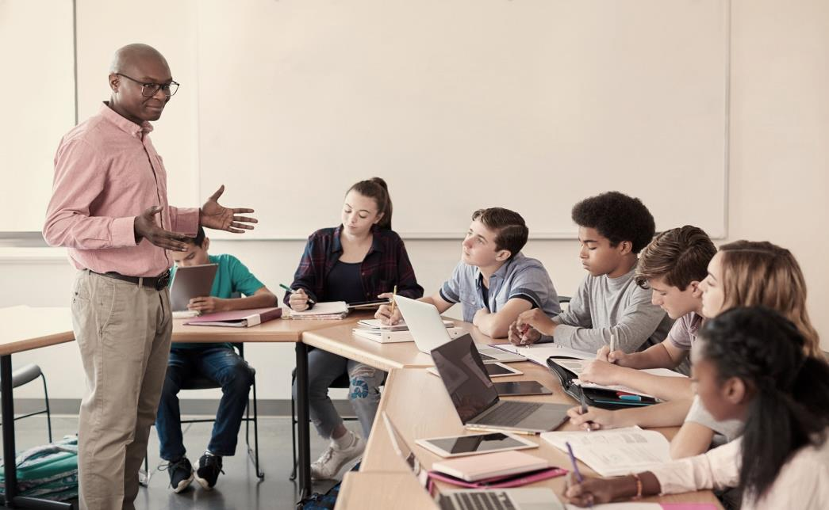
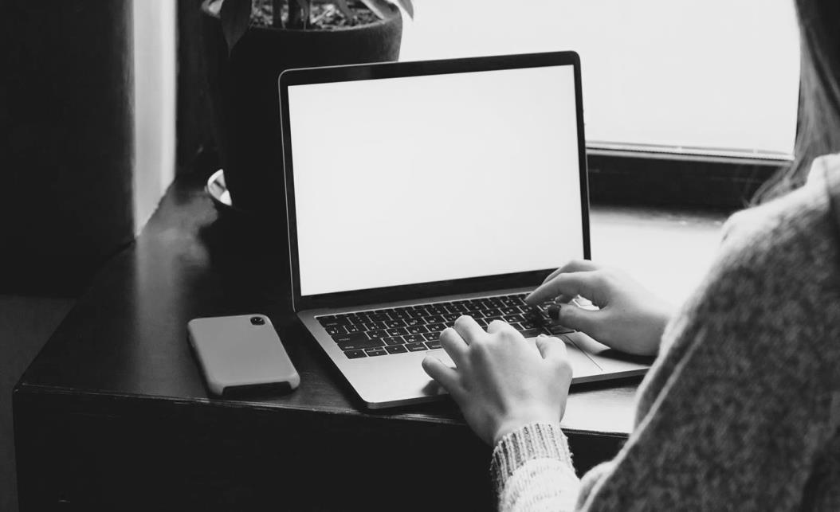
About Project
Project Background
In Face to Face Class
Online Class After Covid 19
understand the class through nonverbal expressions.
A Shorthand helper helped low hearing students in the class.
Become difficult to read nonverbal expressions.
Lack of system to help low hearing students in their classes.
Notes:
In face-to-face classes, hearing impaired students were able to understand the class through nonverbal expressions, and There was support from shorthand helpers. but after covid nineteen, most of the classes turned into an online classes. So It has become difficult to read the professor's nonverbal expressions or the atmosphere of the class. And also There is a lack of a system to help hearing-impaired students in their classes.

Slide 8


About Project
Project Background
BF is…
So we discussed about solution to solve the problem of manpower shortage for disabled students.
We decided to create a platform that connects classmate to low-hearing students.
BF is primarily created as a Online space to recruit Classmate volunteers for the low-hearing students.
These volunteers can provide visual information such as subtitles.
Notes:
So we discussed about how to solve the problem of manpower shortage for disabled students.
And We decided to create a platform named ‘bf’ that connects classmates to help Hearing-impaired friends.
BF is especially created as a Online place to recruit volunteers for the hearing-impaired Students.
Classmates Helper can support visual information such as subtitles for hearing-impaired students.
BF is intended to recruit classmate volunteers.

Slide 9


About Project
Project Objectives
The connection between students overcomes the depression caused by corona blue and stimulates learning motivation.
Supporting students who have trouble studying
in online classes by matching classmate 1:1
Notes:
Because of the corona, almost all classes have been turned into online classes.

Slide 10


About Project
Differentiation
X
Free
X
Delicate
X
in-depth learning effect
Notes:
Because of the corona, almost all classes have been turned into online classes.

Slide 11
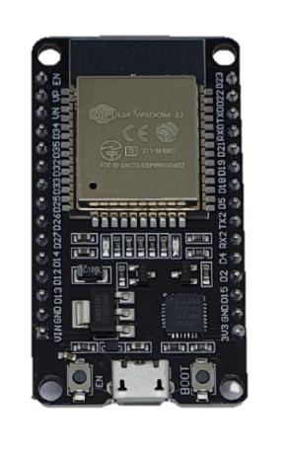

Project Methodolohy
Our team will use Esp32 as a web server for the platform and html, css, and JavaScript to create a web page.
Notes:
Our team will use Esp32 as a web server for the platform and html, css, and JavaScript to create a web page.
There are four main Steps to use our web site. 1. Volunteers can choose a lecture from list that need support.
2. The volunteer can be matched One by one with the low-hearing student. 3. Volunteers receive points that can be exchanged for goods in return for volunteer work. (The exchangeable items are mainly school meal tickets and school souvenirs.) 4. low-hearing students can give feedback on the services they receive.

Slide 12
Process of system
Volunteers can choose a lecture from list that need support.
The volunteer can be matched 1:1 with the low-hearing student.
3. Volunteers receive points that can be exchanged for goods in return for volunteer work. (The exchangeable items are mainly school meal tickets and school souvenirs.)
4. low-hearing students can give feedback on the service they receive.
Notes:
Our team will use Esp32 as a web server for the platform and html, css, and JavaScript to create a web page.
There are four main Steps to use our web site. 1. Volunteers can choose a lecture from list that need support.
2. The volunteer can be matched One by one with the low-hearing student. 3. Volunteers receive points that can be exchanged for goods in return for volunteer work. (The exchangeable items are mainly school meal tickets and school souvenirs.) 4. low-hearing students can give feedback on the services they receive.

Slide 13
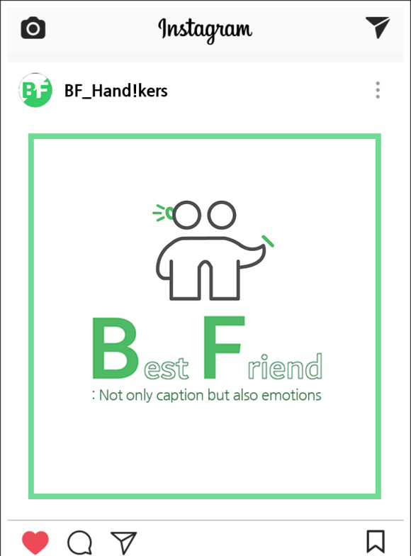
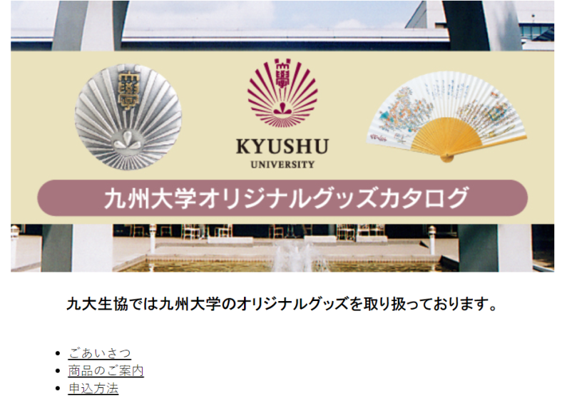
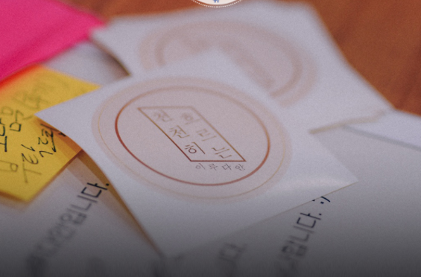
Promotion
Since this project is run with the participation of volunteers, promotion is important to recruit them
・official website
・Club
・SNS
Notes:
Our team will use Esp32 as a web server for the platform and html, css, and JavaScript to create a web page.
There are four main Steps to use our web site. 1. Volunteers can choose a lecture from list that need support.
2. The volunteer can be matched One by one with the low-hearing student. 3. Volunteers receive points that can be exchanged for goods in return for volunteer work. (The exchangeable items are mainly school meal tickets and school souvenirs.) 4. low-hearing students can give feedback on the services they receive.

Slide 14

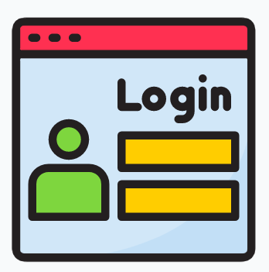

Conclusion
By helping and studying together, we can improve academic ability and the quality of online class environment.
And we can solve Covid19 blue which is a Depression due to social isolation caused by covid-19.
Expansion Plan
Additional pages
Login system
International students
Notes:
-The learning guidance service through 1:1 matching between classemate requires additional pages to actively communicate with each other to differentiate from the existing subtitle service.
- Due to copyright issues in school lectures, only students who take courses should be able to access them, which means the application of the login system.
- First of all, it is a service for students with hearing impairments, but if the size of the platform grows, it can also be implemented for international students and students who have difficulty studying with online lectures. Therefore, a service investigation is required for new users.

Slide 15
Demonstration
BF

Slide 16
Thank you

